Slide 1
GEELY AUTOS PRICE PREDICTION MODEL
Cheshi Emmanuel

Slide 2
PROBLEM STATEMENT
A Chinese automobile company Geely Auto aspires to enter the Nigerian market by setting up its manufacturing unit and producing cars locally to compete with their Nigerian, US and European counterparts.
They have contacted you, a Data Scientist to understand the factors on which the pricing of cars depends. Specifically, they want to understand the factors affecting the pricing of cars in the Nigerian market, since those may be very different from the Chinese market.
The company wants to know:
Which variables are significant in predicting the price of a car
How well do those variables describe the price of a car
Based on various market surveys, you have gathered a large data set of different types of cars across the Nigerian market.

Slide 3
BUSINESS GOAL/OBJECTIVE
To model the price of cars with the available independent variables for management to use it to understand how exactly the prices vary with the independent variables. They can accordingly manipulate the design of the cars, the business strategy etc. to meet certain price levels. Further, the model will be a good way for management to understand the pricing dynamics of a new market.

Slide 4
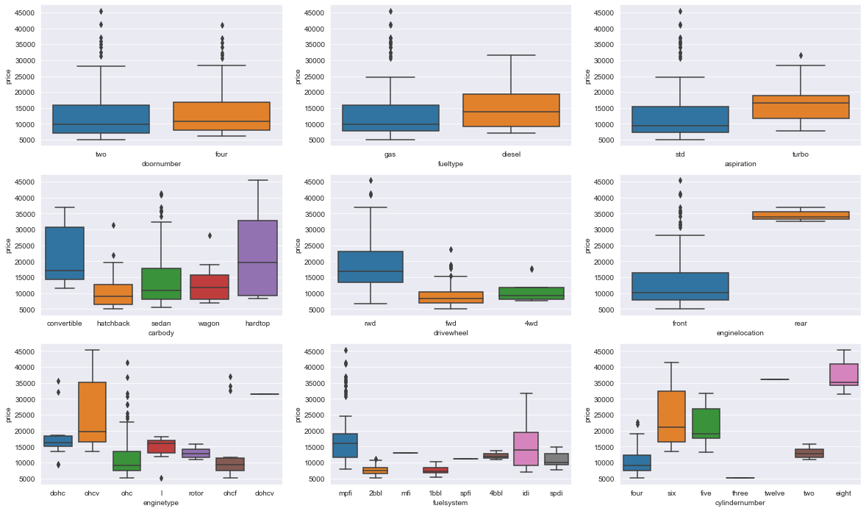
Boxplot Indicating Features of Categorical Variables
Fuel type have an effect on the pricing of the cars.
Engine location and aspiration surely has a visible effect on the pricing of the car
The price of real wheel drive is significantly higher than other drive wheel options.
Cylinder number and engine type also seem to regulate the price of cars.
Hardtop and convertible cars are definitely priced higher than other body types available. Also car body is contributing in determining the price.

Slide 5
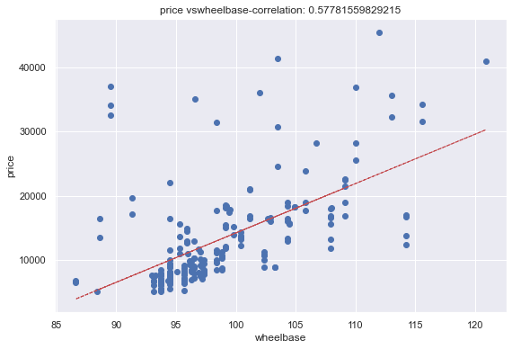
Wheelbase Correlation With Price
From the visualization it can be seen that Wheelbase has a strong positive correlation (0.57)with price. This Indicates that the longer the wheelbase, the higher the price because longer wheel bases tend to have a better ride quality than those with shorter ones.

Slide 6
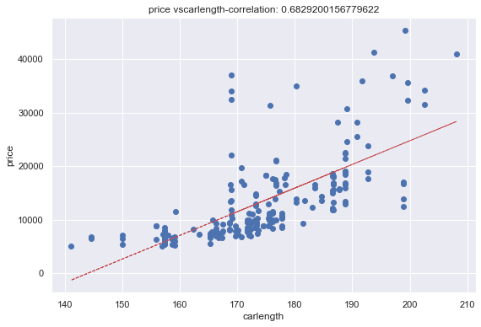
Car Length Correlation With Price
From the visualization it can be seen that car length has a strong positive correlation (0.68)with price.

Slide 7
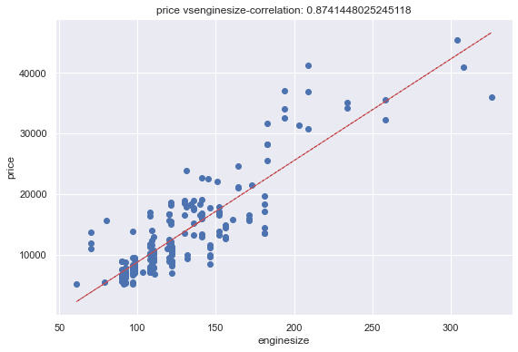
Engine Size Correlation With Price
From the visualization it can be seen that engine size has a strong positive correlation (0.8) with price. This Indicates that the bigger the engine in size, the higher the price because they possess higher turbo charge and have around 150hp making them more expensive than cars with smaller ones.

Slide 8
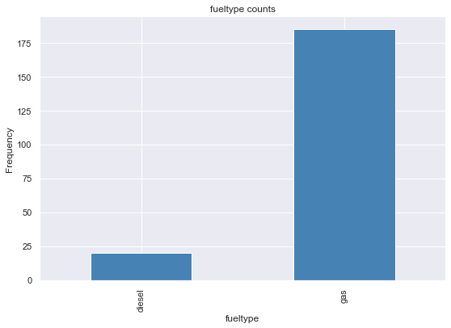
FUEL TYPE PREFERENCE
From the visualization, it can be seen that majority of the cars preferred are the ones that run on gasoline instead of diesel

Slide 9
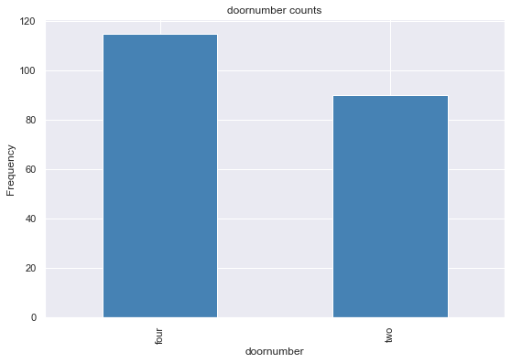
CARS CHOICE BASED ON NUMBER OF DOORS
The visualization indicates that majority of the cars are those with 4 doors against the ones with 2 doors.

Slide 10
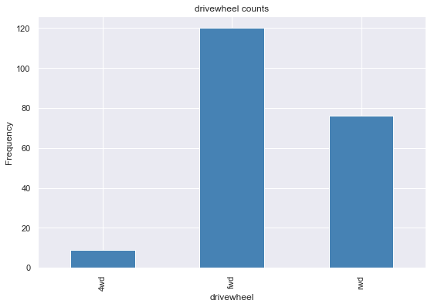
CAR CHOICES BASED ON WHEEL DRIVE
From the visualization the most preferred cars are the ones with the forward wheel drive (FWD) feature.

Slide 11
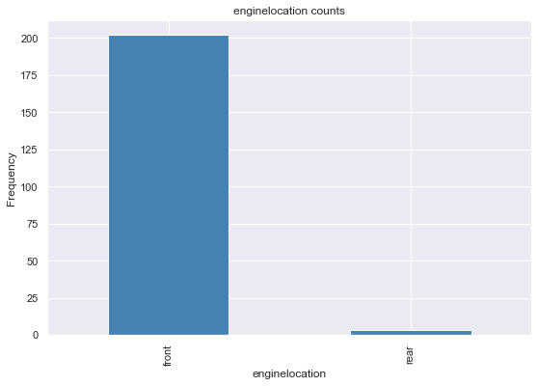
CARS CHOICES BASED ON ENGINE LOCATION
The Visualization indicates that majority of the cars have their engines in front

Slide 12
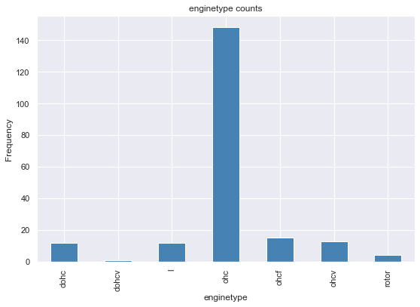
CARS CHOICES BASED ON ENGINE COUNT
This visualization indicates that Overhead Car Engines Were The Most Preferred Engine Type Count

Slide 13
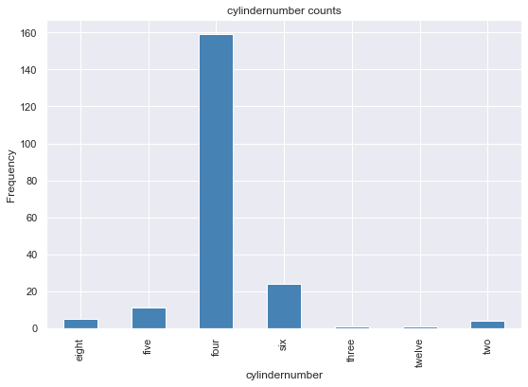
CARS CHOICES BASED ON CYLINDER NUMBER
From the visualization, it can be seen that cars with four cylinders were the most preferred.

Slide 14
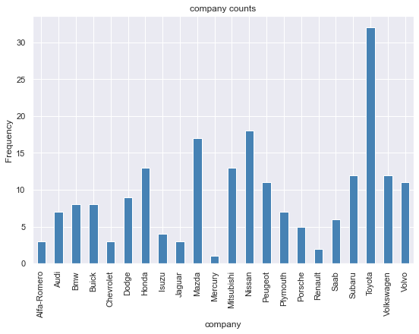
CAR PREFERENCE BASED ON COMPANY
This visualization indicated that the Toyota company has the most users with a count of 32, followed by Nissan 18 and the Mazda with a count of 17.

Slide 15
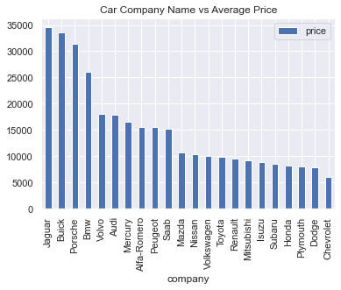
AVERAGE CAR PRICE OF COMPANIES
This visualization indicates that Jaguar company by average has the average price.

Slide 16
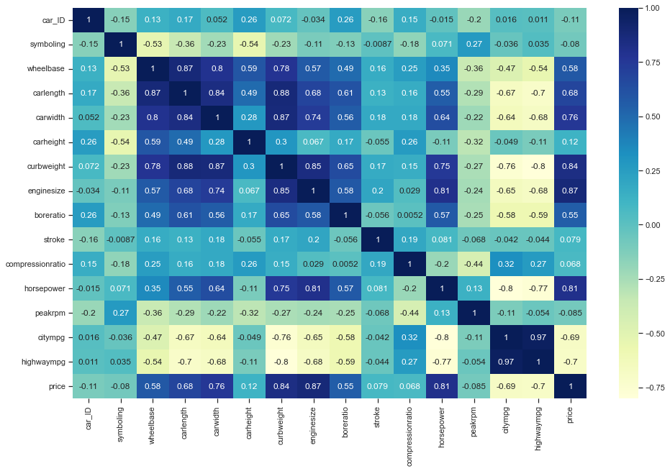
A HEATMAP INDICATING THE RELATIONSHIPS BETWEEN INDIVIDUAL VARIABLES
The Visualization indicates that car price has very strong correlation with engine size, car width, engine type, wheel base, car length, horse power, curb weight, bore ratio, stroke, compression ratio.

Slide 17
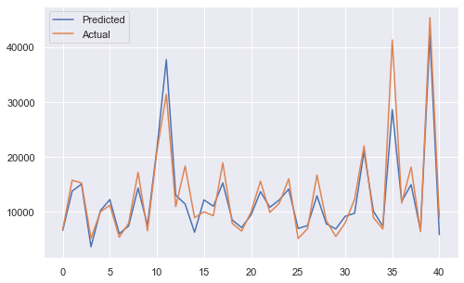
ACTUAL PRICE VERSUS PREDICTED PRICE GRAPGH
This visualization indicates the actual prices against the model prediction price with their individual represented legends.
The test vs predicted results almost overlap each other which shows good prediction.

Slide 18
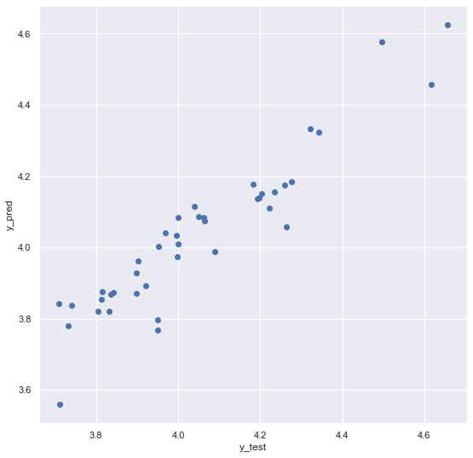
SCATTERPLOT INDICATING NEW PREDICTED PRICE VERSUS INITIAL PRICE
This visualization indicates that the is a strong positive correlation between our new predicting price model. This implies that with an R-squared value of 0.8834 and adjusted R-squared value of 0.708 the model perfectly predicted our prices

Slide 19
OBSERVATIONS AND CONCLUSION
From the model predictions and visualizations, the following observations were made:
Fuel type had more effect on the pricing of the cars.
Engine location and aspiration also has a visible effect on the pricing of the car
The price of rear wheel drive is significantly higher than other drive wheel options.
Cylinder number and engine type also seem to regulate the price of cars.
Hardtop and convertible cars are definitely priced higher than other body types available. Also car body is contributing in determining the price.
Diesel Cars had comparatively more car prices than gas car.

Slide 20
OBSERVATIONS AND CONCLUSION
Turbo aspiration has more prices
Hardtop and convertible carbody has higher prices than others
RWD (Rear Wheel Drive) has higher average prices.
Rear engine location has very high price comparatively than front location.
Prices are affected by numbers of cylinder number.
Door numbers doesn have much affect the prices of a car

Slide 21
OBSERVATIONS AND CONCLUSION
The variables/features which are significant in predicting the price of a car are:
Engine Size
Car Width
Engine Type
Wheel Base
Car Length
Horse Power
Curb Weight
Bore Ratio
Stroke
Compression Ratio

Slide 22
FINAL ANALYSIS AND RECOMMENDATIONS
Geely Auto can use the above features to determine the price of a car which they are about to distribute in the Nigeria market.
Along with that, our initial analysis brought out some valiant features which has a huge impact on the price of a car. These are summarized again below:-
1. Company Name - Brand value is a big factor. Companies such as Porsche, BMW, Jaguar produce some expensive cars. So price depends a lot on the company of the car.
2. Symbolling - Cars symbolled safe have a higher price range than others.

Slide 23
FINAL ANALYSIS AND RECOMMENDATIONS
3. Fuel type - Diesel powered cars tend to be very slightly expensive than their petrol counterparts. This could be because diesel is less expensive than petrol and thus a diesel car willcost less over time.
4. Engine Location - Cars with engines on the rear are significantly more expensive than the cars with engine on the front. This is mainly because the expensive sports cars have engine towards the back for better balance at high speeds and aerodynamic enhancement.
5. Cylinder Number - With the increase in the number of cylinders, the prices increase as well

